Slide 1
Assisting Bariatric Patients at Emergency incidents and Non-Emergency requests:
Exploring roles and challenges in bariatric patient assistance
Notes:
This presentation discusses the critical role of fire and rescue services in providing assistance to bariatric patients in emergency incidents and non-emergency scenarios. We will explore statutory duty, liabilities, risk assessment, roles and responsibilities for partner agencies, protocols, operational challenges, and legal considerations surrounding this topic.
Bariatric is defined as a patient who is over 25 stone. The Trust has chosen to widen its definition of a bariatric person and for the purposes of this policy a bariatric person is any person with a heavy body size/shape which will significantly impact on the management of an event involving Service Providers.
https://www.google.com/url?sa=t&rct=j&q=&esrc=s&source=web&cd=&ved=2ahUKEwjIzfq2ipmMAxVtX0EAHToXIYkQFnoECBUQAQ&url=https%3A%2F%2Fwww.scas.nhs.uk%2Fwp-content%2Fuploads%2F2022%2F06%2FBariatric-Policy-1.pdf&usg=AOvVaw3zcX-mcx8xF19iYswzZbG0&opi=89978449

Slide 2
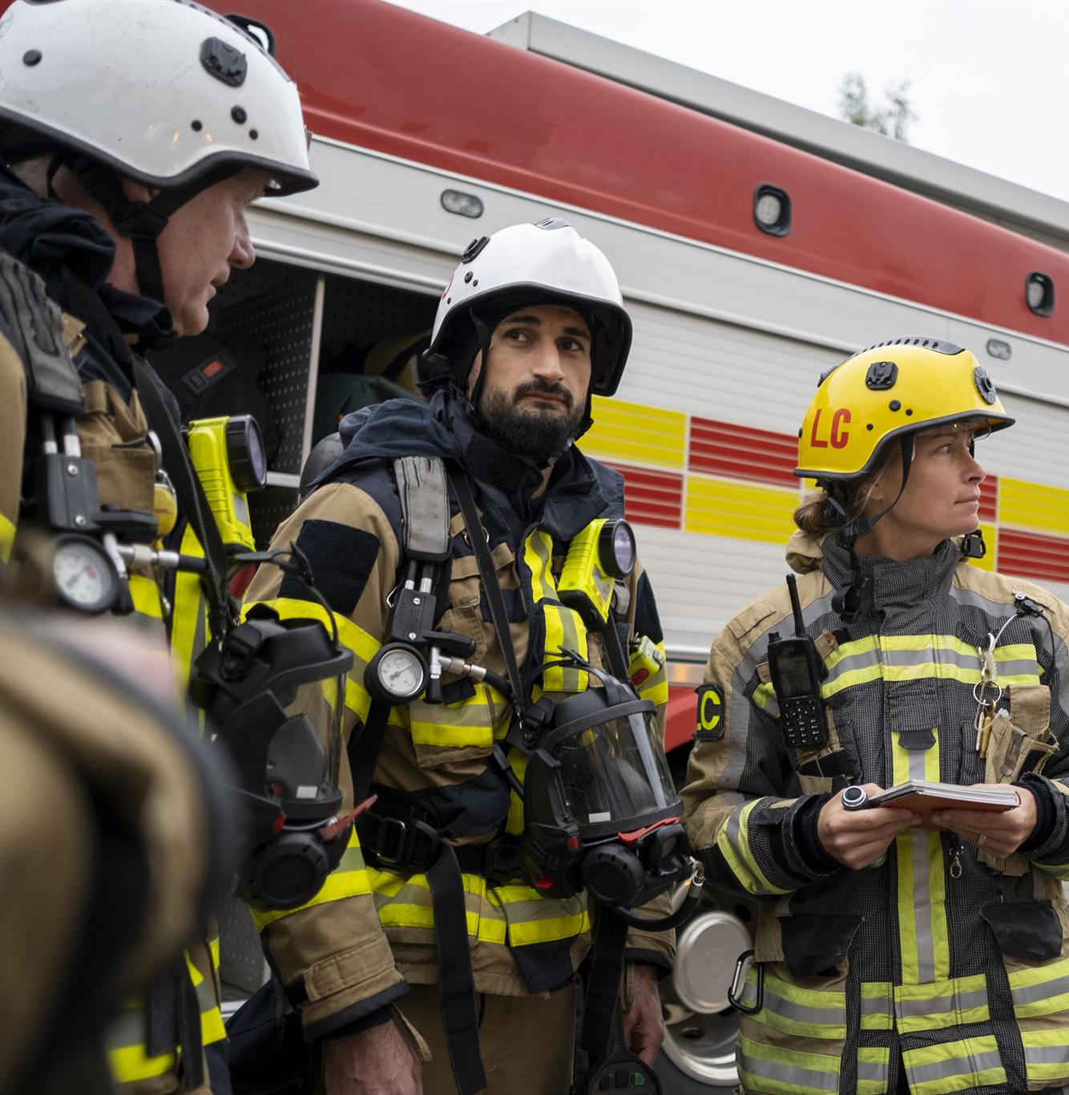
Agenda Items
Overview of Assistance Protocols
Hierarchical Response Protocols
Non-Emergency Requests and Concerns
Operational Challenges
Legal and Insurance Considerations
Notes:
We will begin by reviewing the assistance protocols that guide fire and rescue services in their interaction with bariatric patients. Next, we'll delve into hierarchical response protocols within ambulance services. Following that, we'll discuss non-emergency requests and concerns, operational challenges faced by responders, and conclude with legal and insurance considerations.

Slide 3
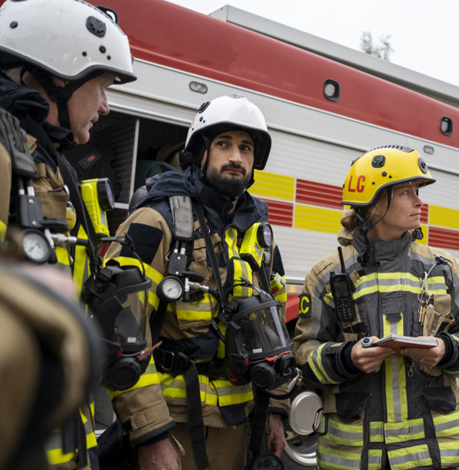
Role of Fire and Rescue Services in Assisting Bariatric Patients
Emergency Assistance
Fire and rescue services play a vital role in providing emergency assistance to bariatric patients during critical situations.
Specialised Equipment
They are trained to use specialised equipment designed for the safe transport and handling of bariatric patients.
Safe Handling Techniques
Fire and rescue personnel are trained in safe handling techniques that minimise risk during bariatric patient transport.
Notes:
Understanding assistance protocols is essential for effective intervention. Fire and rescue services play a vital role in supporting bariatric patients, ensuring their safe transport and care during emergencies.
Fire and rescue services provide crucial assistance to bariatric patients who may require additional help during transport and emergency situations. Their training includes using specialised equipment and techniques for safe handling.

Slide 4

Collaboration with Ambulance Services
Importance of Collaboration
Collaboration between fire and rescue services and ambulance teams ensures effective patient care during emergencies.
Joint Training Programs
Joint training sessions between emergency services improve coordination and readiness for handling bariatric patients.
Communication Protocols
Establishing clear communication protocols enhances the response efficiency and patient outcomes in emergencies.
Notes:
Collaboration between fire and rescue services and ambulance teams is vital for effective patient care. Joint training and communication protocols enhance the overall response to bariatric patients.

Slide 5

Legal Implications of Assisting Bariatric Patients
Duty of Care
Healthcare professionals have a legal obligation to provide appropriate care to bariatric patients, ensuring their safety and well-being.
Potential Liabilities
Understanding potential liabilities is crucial for caregivers to avoid legal issues while assisting bariatric patients.
Legal Compliance
Fire and rescue services must understand legal implications when assisting bariatric patients to ensure compliance with relevant laws.
Standardised Procedures
Clear policies and guidelines ensure standardised procedures for assisting bariatric patients, improving overall care quality.
Mitigating Legal Risks
Well-defined frameworks help mitigate legal risks by providing clarity on responsibilities and procedures.
Improved Patient Outcomes
Implementing clear guidelines can lead to improved patient outcomes and enhance the quality of care provided.
Notes:
Legal and insurance considerations are paramount when assisting bariatric patients. It's essential to be aware of potential liabilities and ensure that policies are in place to protect both patients and responders.
Assisting bariatric patients can involve various legal implications, including duty of care and potential liabilities. Understanding these laws is essential for fire and rescue services.
There is a critical need for clear policies and guidelines that outline the procedures for assisting bariatric patients. These frameworks help to standardise responses and mitigate legal risks.

Slide 6

Insurance Coverage for Potential Injuries or Property Damage
Importance of Insurance Coverage
Insurance coverage is crucial for protecting service providers against potential liabilities and ensuring safety during assistance.
Protection for Service Providers
Adequate insurance coverage safeguards service providers from financial losses incurred due to injuries or property damage during assistance.
Patient Safety Assurance
Proper insurance coverage also ensures that patients receive necessary care without financial concerns impacting their treatment.
Notes:
Insurance coverage for injuries or property damage during assistance is an important consideration. Ensuring appropriate coverage protects both the service providers and the patients.

Slide 7
Non-Emergency Requests and Concerns
Notes:
Non-emergency requests pose unique challenges and concerns for fire and rescue services. Understanding these issues is vital for effective resource management and responding to community needs.

Slide 8

Resource Allocation for Non-Emergency Calls
Strain on Services
Non-emergency calls can significantly strain the available resources of service providers, impacting overall effectiveness. Prioritisation of life-threatening situations over non-critical requests to ensure maximum safety.
Effective Resource Distribution
Evaluating resource distribution is essential to ensure quick responses to both emergency and non-emergency situations.
Balancing Needs
Striking a balance between emergency and non-emergency response is crucial for maintaining service delivery.
Notes:
Resource allocation for non-emergency calls can strain available services. It's essential to evaluate how resources are distributed to respond effectively to both emergency and non-emergency situations.

Slide 9
Reluctance to Respond to Non-Critical Requests
Prioritisation of Emergencies
Fire and rescue services prioritise life-threatening situations over non-critical requests to ensure maximum safety.
Resource Management
Effective resource management is crucial for responding to emergencies, impacting the willingness to address non-critical requests.
Balancing Needs
Finding a balance between urgent needs and available resources is essential for service delivery in fire and rescue operations.
Notes:
There can be reluctance among fire and rescue services to respond to non-critical requests due to prioritisation of life-threatening situations. It's important to find a balance between need and resource availability.

Slide 10

Prioritisation of Life-Threatening Situations
Importance of Prioritisation
Prioritising life-threatening situations is crucial for effective emergency response and resource allocation.
Assessment Criteria Development
Developing clear assessment criteria helps emergency services identify the most critical situations efficiently.
Notes:
Prioritising life-threatening situations ensures that emergency services are deployed where they are most needed. Developing clear assessment criteria can aid in making these determinations.

Slide 11
Operational Challenges
Notes:
Operational challenges affect how effectively fire and rescue services can assist bariatric patients. Addressing these challenges is crucial for improving service delivery and patient care.

Slide 12

Increase in Non-Emergency Requests
Rise in Non-Emergency Requests
There has been a significant increase in non-emergency requests for assistance across various healthcare settings.
Focus on Bariatric Patients
Bariatric patients have contributed to this increase, highlighting the need for tailored assistance strategies.
Need for Strategy Reevaluation
This trend requires a reevaluation of existing response strategies to ensure effective patient care and resource allocation.
Notes:
There has been a noticeable increase in non-emergency requests for assistance, particularly from bariatric patients. This trend necessitates a reevaluation of response strategies.

Slide 13
Limited Resources of Ambulance Crews
Resource Limitations
Ambulance crews often encounter limited medical supplies and personnel, hindering effective emergency responses.
Impact on Response Time
Limited resources can lead to increased response times, which can affect patient outcomes during emergencies.
Strategising Solutions
Understanding limitations allows for strategising solutions to enhance efficiency and improve response capabilities.
Notes:
Ambulance crews often face limited resources, which can impede their ability to respond effectively. Understanding these limitations helps in strategising more efficient responses.

Slide 14

Role of Care Providers in Routine Assistance
Support for Bariatric Patients
Care providers offer essential support to bariatric patients, ensuring their needs are met in daily routines.
Reducing Emergency Service Pressure
By providing routine assistance, care providers help reduce the burden on emergency services for non-emergency situations.
Importance of Routine Care
Routine care is crucial for bariatric patients, promoting better health outcomes and overall well-being.
Notes:
Care providers play a significant role in offering routine assistance to bariatric patients. Their involvement can alleviate some pressure on emergency services when addressing non-emergency needs.

Slide 15
Conclusion
Unique Challenges
Fire and rescue services encounter unique challenges when assisting bariatric patients, requiring specialised knowledge and skills.
Understanding Protocols
Understanding and following established protocols is essential for providing safe and effective support to bariatric patients.
Operational Challenges
Addressing operational challenges, such as equipment and crew training, is vital for improving service delivery.
Legal Implications
Being aware of the legal implications related to assisting bariatric patients ensures compliance and protection for services.
Notes:
In conclusion, assisting bariatric patients in non-emergency situations presents unique challenges and considerations for fire and rescue services. By understanding protocols, addressing operational challenges, and being aware of legal implications, services can enhance their support for this vulnerable population.

