Slide 1
Member Interest Group
Aquagas S.19 Hydrant
6 February 2025
Notes:
Welcome members and Thomas Miller: Sophia Reed, Mutual Manager, Ben Lambert and Emma Jones, FRIC claims handlers.
meeting for FRIC members on the 6th of February 2025. During this meeting, we aim to discuss a range of important concerns, including FRIC protection, potential liability issues associated with using equipment classified as defective by water companies, and risk mitigation options to inform Member decision-making.
Please add in chat what you are expecting from this session.
NOTE: As Managers, Thomas Miller is not permitted to give advice, especially legal advice, to FRIC’s Members, as it is not qualified to do so. We recommend that if Members wish to understand where the conflict between the statutory duty to provide water and the duty to ensure the safety of employees might sit legally, they should speak to their own legal advisors. We would of course welcome sight of any such advice should it become available.

Slide 2
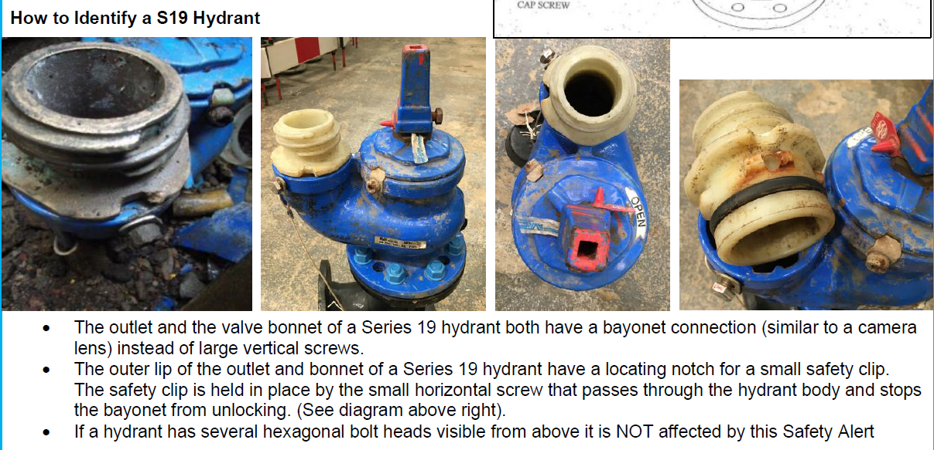
Aquagas S.19 Hydrant
The outlet and the value bonnet of a S.19 hydrant both have a bayonet connection (similar to a camera lens) instead of large vertical screws.
The outer lip of the outlet and bonnet of a S.19 have a locating notch for a small safety clip. The safety clip is held in place by the small horizontal screw that passes through the hydrant body and stops the bayonet from unlocking.
If a hydrant has several hexagonal bolt heads visible from above it is NOT affected by NFCC safety alert.
Notes:
This particular issues seems to have been highlighted as far back as 2017/2018, there are several documents available.
NFCC working group meeting of 5th of November 2024, the group agreed that after review of the actual incidents that have accrued and consultation with legal teams the series 19 hydrants shouldn’t be exempt from use and that Fire & Rescue services should treat all hydrants the same, being, that all hydrants pose a risk and therefore all personnel using a hydrant should do the necessary risk assessment checks, and wear the correct PPE, if any reason is found to deem the hydrant unsafe they should seek alternative sources i.e. different hydrant, washout or Emergency water supply.

Slide 3
Member responses
Issues and/or mitigation for 2-bolt hydrant erosion;
5 - reported S.19 hydrants erosion.
1 - S.19 hydrant not used.
4 - Water companies have either replaced eroded hydrants or installed clamps at their expense, no cost incurred by FRS.
4 - regular meetings with water companies, reporting of defective hydrants with agreement on repair / replacement schedules.
1 - water company not replaced or repaired reported defects or provided safety clamps.
1 - initially water company replacing however this proved costly, strategy to use safety clamps.
Notes:
Responses from 9 FRS:
Issues and/or mitigation for 2-bolt hydrant erosion
5/9 reported issues with S.19 hydrants.
1/9 reported no issues hydrant type not used.
4/9 Water companies have either replaced eroded hydrants or installed clamps at their expense, no cost incurred by FRS.
4/9 regular meetings with water companies, reporting of defective hydrants with agreement on repair / replacement schedules. 1/6 water company not replaced or repaired reported defects or provided safety clamps. 1/6 initially water company replacing however this proved costly, switching strategy to install safety clamps.
5/9 have established in and out of office hours contacts, meet regularly with water companies, added hydrant status to MDTs.
All issued Ops H&S safety bulletins.
NFCC
the NFCC water officers group in putting together relevant guidance.

Slide 4
Member responses
Defective hydrants being unavailable for use;
9 FRS reports range from by exception hydrants not available, 0.53% unavailable to large majority of hydrants defective.
Majority S.19 repaired, or safety clamp installed promptly by water company.
3 FRS monitors attempted hydrant usage which is less than 1 per year, information held on appliances MDTs (mobile data terminals).
Notes:
Responses from 9 FRS:
Issues and/or mitigation for 2-bolt hydrant erosion
5 x report that it is by exception hydrants not available, ranging from 0.53% unavailable to large majority of hydrants defective.
Majority are repaired or safety clamp installed promptly by water company.
1 x FRS monitors attempted hydrant usage which is less than 1 per year, information held on appliances MDTs (mobile data terminals).
NFCC
the NFCC water officers group in putting together relevant guidance.
He has also worked closely with Yorkshire Water in identifying problem hydrants and an initial strategy of replacement at no cost to WYFRS as well as guidance to operational crews on how to operate these hydrants safely if required at an incident. This approach was proving costly to Yorkshire Water and they have collaborated in designing a safety clamp to fit to all series 19 defective hydrants to ensure their safe operability.

Slide 5
Member responses
Defective hydrants not being repaired;
7 - report hydrant repairs completed within an acceptable timeframe.
1 - reported repairs not completed for more than 12 months.
Notes:
Responses from 9 FRS:
Defective hydrants being unavailable for use
5/9 report that it is by exception hydrants not available, ranging from 0.53% unavailable to large majority defective. Majority are repaired or safety clamp installed promptly by water company. One FRS monitors attempted hydrant usage which is less than 1 per year, information held on appliances MDTs (mobile data terminals).

Slide 6
Member responses
Hydrant-related safety events and near misses;
5 - no known safety events or near misses.
1 - reported near miss, technician installed safety clamp.
Notes:
Responses from 9 FRS:
Hydrant-related safety events and near misses
5/9 report on known safety events or near misses. 1/6 reported near miss – technician installed safety clamp.

Slide 7
Member responses
Any other concerns;
New developments where adequate fire hydrants are not formally planned in as part of the infrastructure design planning process. This should be a condition of planning in the initial design stage following the 90 rules. (no property further than 90 meters from a hydrant and on a minimum of a 90mm main).
Third parties can access hydrants, building sites, anyone who needs to draw water but they need a meter and a permission from the water company. Concern is the lane rental scheme that is being introduced by some counties April 2025. Financial concern as the charges are max £2500.
Notes:
Responses from 9 FRS:
Any concerns with hydrant use
The big issue that insurers should be aware of is new developments where adequate fire hydrants are not formally planned in as part of the infrastructure design planning process. This should be a condition of planning in the initial design stage following the 90 rules. (no property further than 90 meters from a hydrant and on a minimum of a 90mm main). Maybe pressure from Insurers stipulating this for new developments would improve safety and reduce losses.”
Any concerns with hydrant use. Third parties can access hydrants, building sites, anyone who needs to draw water but they need a meter and a permission from the water company. Concern is the lane rental scheme that is being introduced by ESCC in April 2025. Financial concern as the charges are max £2500.
Considered carrying the hydrant clamps on fire engines, but this will delay water availability and not all hydrants are easily accessible.
We receive and monitor reports of hydrants used. Issues raised are most often the rate of water output (or lack of it) and dirty chambers. Mechanical defects are occasionally reported, but these can occur at any time in spite of routine inspection and maintenance. Defects and issues reported following hydrant used are followed up.
What does FRIC cover if FF uses a defective hydrant and is injured or member of public

Slide 8
Safety control measures
Safety Training: Safety measures and training are in place to ensure that personnel are aware of the risks and know how to handle S.19 hydrants safely.
Inspection and Reporting: S.19 hydrants are identified during the inspection process and reported to water companies for repair or the fitting of safety clamps.
Safety Clamps: Consider carrying hydrant clamps on fire engines to allow safer use of the hydrants, although this may delay water availability.
Monitoring and Bulletins: Monitor usage reports to see if attempts are made to use hydrants shown as out of use. Issue safety bulletins to address any near misses or safety events.
Situational Awareness: Employees are advised to stop and think about their situational awareness, checking that the hydrant being used is not of the S.19 type.
Safety Tags: If a S.19 hydrant is identified, it should not be used, and a dangerous fire hydrant tag should be placed to warn others.
Escalate risk: report hydrant defect status to strategic safety committee and / or escalate as a corporate risk.
Notes:
The NFCC hydrants working group meeting of 5th of November 2024, the group agreed that after review of the actual incidents that have accrued and consultation with legal teams the series 19 hydrants shouldn’t be exempt from use and that Fire & Rescue services should treat all hydrants the same, being, that all hydrants pose a risk and therefore all personnel using a hydrant should do the necessary risk assessment checks, and wear the correct PPE, if any reason is found to deem the hydrant unsafe they should seek alternative sources i.e. different hydrant, washout or Emergency water supply.
Connect the dots by recording hydrant defects, understanding level of near misses and safety events, report status to strategic safety committee and / or escalate hydrant risk to executive board corporate risk register so that senior management understand the scale and scope of defects, impact on operational response and water availability. They can talk with water companies at a strategic level and make informed decisions whether FFs use defective hydrants.

Slide 9


FRIC Protection
Notes:
FRIC has considered how such a situation might impact on its approach to dealing with any claims that arise as a result of a defecting hydrant incident. Under normal circumstances, an injury to an employee involving a defective hydrant would be considered by FRIC in the normal way, and depending on the circumstances, FRIC might look to subrogate the claim to the water company that installed the hydrant on the grounds it was defective or not fit for purpose, thus limiting its losses, and potentially that of the member. It is our view however, that given the instruction to stop using these hydrants that has been issued, should an injury occur, the subrogation option would not be available, leaving FRIC to deal with the claim itself. In the event that liability is accepted, FRIC would meet the claim, subject to any deductible payable by the member. It is likely that a court would deem the FRA to have been negligent in acting against the advise of the water company, thus triggering the protection. For the avoidance of doubt, it is our belief that any injury to a third party user, whether officially authorised by the water company or not, would not result in a successful claim against the FRA.
NFCC hydrants working group meeting of 5th of November 2024, the group agreed that after review of the actual incidents that have accrued and consultation with legal teams the series 19 hydrants shouldn’t be exempt from use and that Fire & Rescue services should treat all hydrants the same, being, that all hydrants pose a risk and therefore all personnel using a hydrant should do the necessary risk assessment checks, and wear the correct PPE, if any reason is found to deem the hydrant unsafe they should seek alternative sources i.e. different hydrant, washout or Emergency water supply.

Slide 10
FRIC Guidance
Notes:
FRIC has considered how such a situation might impact on its approach to dealing with any claims that arise as a result of a defecting hydrant incident. Under normal circumstances, an injury to an employee involving a defective hydrant would be considered by FRIC in the normal way, and depending on the circumstances, FRIC might look to subrogate the claim to the water company that installed the hydrant on the grounds it was defective or not fit for purpose, thus limiting its losses, and potentially that of the member. It is our view however, that given the instruction to stop using these hydrants that has been issued, should an injury occur, the subrogation option would not be available, leaving FRIC to deal with the claim itself. In the event that liability is accepted, FRIC would meet the claim, subject to any deductible payable by the member. It is likely that a court would deem the FRA to have been negligent in acting against the advise of the water company, thus triggering the protection. For the avoidance of doubt, it is our belief that any injury to a third party user, whether officially authorised by the water company or not, would not result in a successful claim against the FRA.
NOTE: As Managers, Thomas Miller is not permitted to give advice, especially legal advice, to FRIC’s Members, as it is not qualified to do so. We recommend that if Members wish to understand where the conflict between the statutory duty to provide water and the duty to ensure the safety of employees might sit legally, they should speak to their own legal advisors. We would of course welcome sight of any such advice should it become available.

Slide 11
Summary
Aims, key issues and safety control measures.
FRIC protection and guidance note.
NFCC water officer group in putting together relevant guidance:
NFCC hydrants working group meeting of 5th of November 2024, agreed that after review of the actual incidents that have accrued and consultation with legal teams the series 19 hydrants shouldn’t be exempt from use and that Fire & Rescue services should treat all hydrants the same, being, that all hydrants pose a risk and therefore all personnel using a hydrant should do the necessary risk assessment checks, and wear the correct PPE, if any reason is found to deem the hydrant unsafe they should seek alternative sources i.e. different hydrant, washout or Emergency water supply.
Notes:
NFCC hydrants working group meeting of 5th of November 2024, the group agreed that after review of the actual incidents that have accrued and consultation with legal teams the series 19 hydrants shouldn’t be exempt from use and that Fire & Rescue services should treat all hydrants the same, being, that all hydrants pose a risk and therefore all personnel using a hydrant should do the necessary risk assessment checks, and wear the correct PPE, if any reason is found to deem the hydrant unsafe they should seek alternative sources i.e. different hydrant, washout or Emergency water supply.
NOTE: As Managers, Thomas Miller is not permitted to give advice, especially legal advice, to FRIC’s Members, as it is not qualified to do so. We recommend that if Members wish to understand where the conflict between the statutory duty to provide water and the duty to ensure the safety of employees might sit legally, they should speak to their own legal advisors. We would of course welcome sight of any such advice should it become available.

Slide 12

Aquagas S19 Hydrants

