Slide 1

Welcome to…
Nic Warmink
Head of Claims
Notes:
Before we begin, I’d like to share a bit of background to set the stage. I don’t have all the answers, so I’ll be looking to you for your insights and expertise as we go. Thank you for being here today and I hope you find this session valuable and engaging. Focus on Motor claims that account for over 75% of all claims, followed by liability 19% with 80%) being notification only and 4 % Property claims - All MI you will see in my presentation is from Power BI and if you feel you need more training on Power BI, please let us know and we can arrange this.
And for MI to work well and for comparison purposes, it is so important that all Members are consistent in their claims and notification reporting.

Slide 2
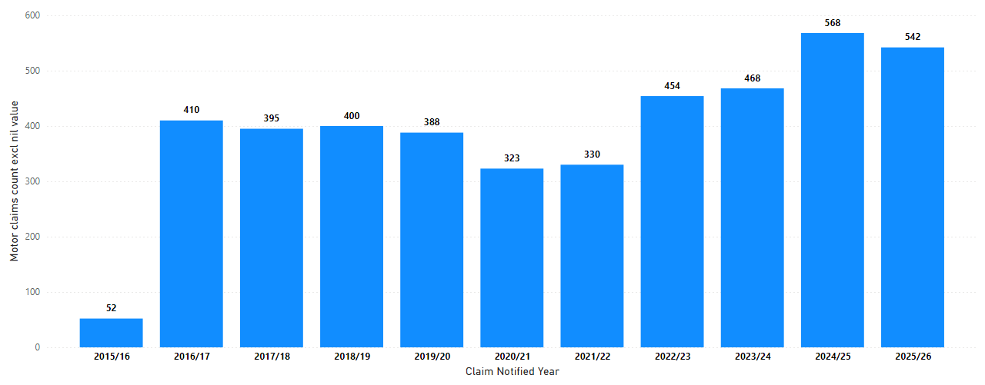
Motor Claims Count excl Nil value
Notes:
Here’s some background information: Since 2015, approximately 4,330 motor claims (excluding nil-value claims) (with nil its over 7000)have been recorded by Authority members. All management information (MI) is sourced from Power BI, which you should have access to.“ Covid years it dropped and since then with new additional members volumes have increased

Slide 3
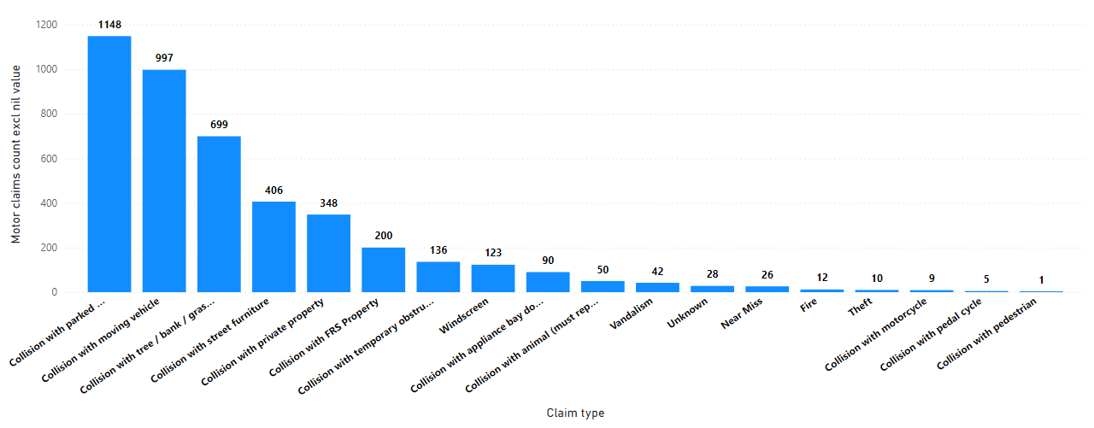
Motor Claims Count excl Nil by Type
Notes:
One of the things I would like to focus on today is the scary stat that nearly 1 in 3 claims involves Collision with Parked vehicle! One in 6 Collision with tree / bank and grass verge – seems high or makes sense to you?

Slide 4
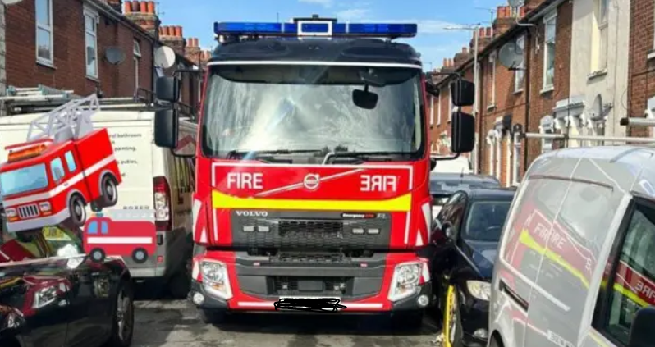
Average Cost for Collision with parked and Unattended Vehicle ?
Notes:
Its not just your own damage , which is mostly minor , but also the third-party damage and possible hire/ credit hire .

Slide 5
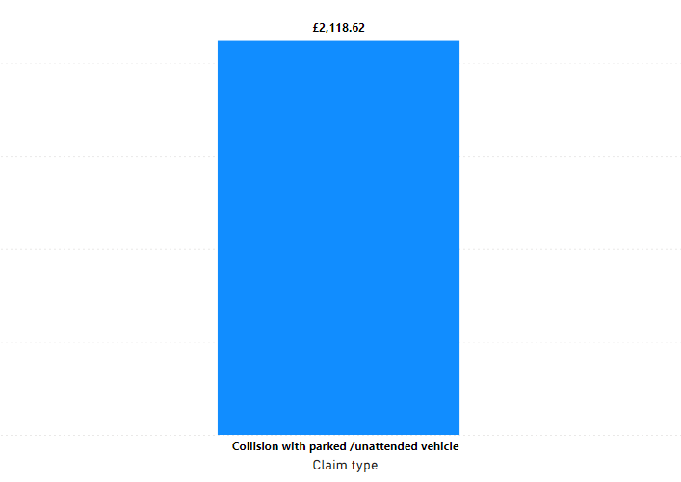

£2,175
Average Cost for Collision with parked and Unattended Vehicle
Notes:
So far total cost us so far about £2.3m

Slide 6
Average Cost of a wing mirror?
The average cost of replacing a wing mirror in the UK varies depending on the type of mirror, the car model, and whether you're using a main dealer or an independent garage
Type of Wing Mirror
Manual mirrors: Basic and cheapest to replace.
Electric mirrors: More expensive due to motors and wiring.
Heated mirrors: Add cost due to heating elements.
Power-folding mirrors: Even more expensive due to additional motors.
Auto-dimming or blind spot detection: Advanced features increase cost significantly.
Make and Model of the Vehicle
Luxury or premium brands (e.g., BMW, Audi, Mercedes): Tend to have more expensive parts.
Common brands (e.g., Ford, Vauxhall, Toyota): Usually cheaper and more readily available.
🛠️ Labour Costs
Labour charges vary by:
Location (London and the South East are typically more expensive).
Type of garage (main dealer vs. independent).
Time required (complex mirrors take longer to fit).
Notes:
Its not just a wing mirror anymore and they are not cheap! Its all the other scrapes, paint work ,more technological advances cars etc
Any guesses of average cost of a wing mirror before we go to next slide .

Slide 7
🧩 OEM vs. Aftermarket Parts
OEM (Original Equipment Manufacturer): More expensive but guaranteed fit and quality.
Aftermarket: Cheaper, but quality and compatibility can vary
.
📦 Extent of Damage
Just the mirror glass: Inexpensive and often DIY-replaceable.
Full unit (housing, motor, indicators): Much more costly.
Anything from £30 to £1500!

Slide 8
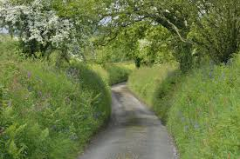
Average Cost for Collision with tree, bank and grass verge?
Notes:
Any guesses? Also, it’s more prevalent in rural areas of the country……

Slide 9
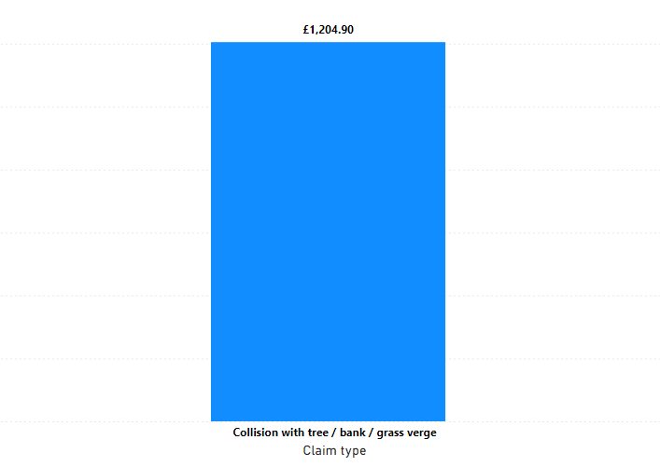

£1,181
Average Cost for Collision with tree, bank and grass verge
Notes:
Average cost for Collision with Tree/ Bank and grass verge £1181

Slide 10
Third Party Capture and Intervention
2 Fold :
Control TP damage costs
Control Credit Hire costs
How - Use of Bump Cards and early reporting by Members
Average cost to FRIC when we capture a TP and provide Spot hire using our hire providers = £840
Average cost to FRIC when we do not capture the TP and they go to Credit Hire = £2,330 !
Notes:
Credit Hire background slide High capturer rate due to speedy notification , bump cards and KPI within 2-4 days etc…….

Slide 11
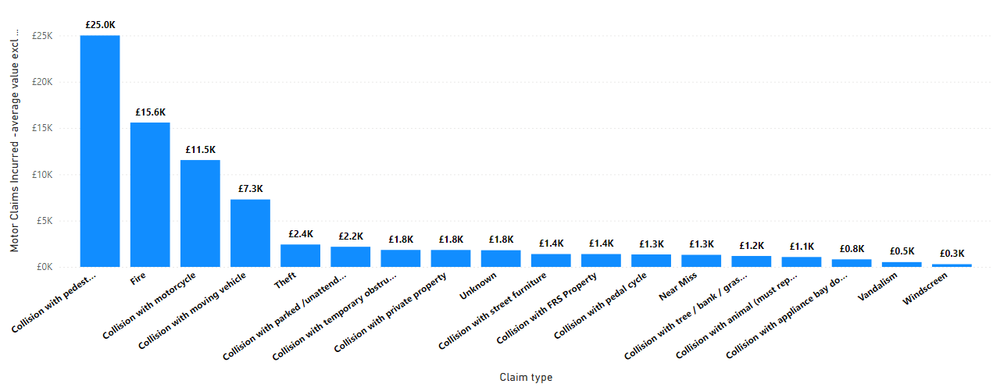
Average cost by Type of Claim
Notes:
Average cost by Type of Claim and as you can see colliding with a motor cycle can be costly but thankfully we have only had a few [6]

Slide 12
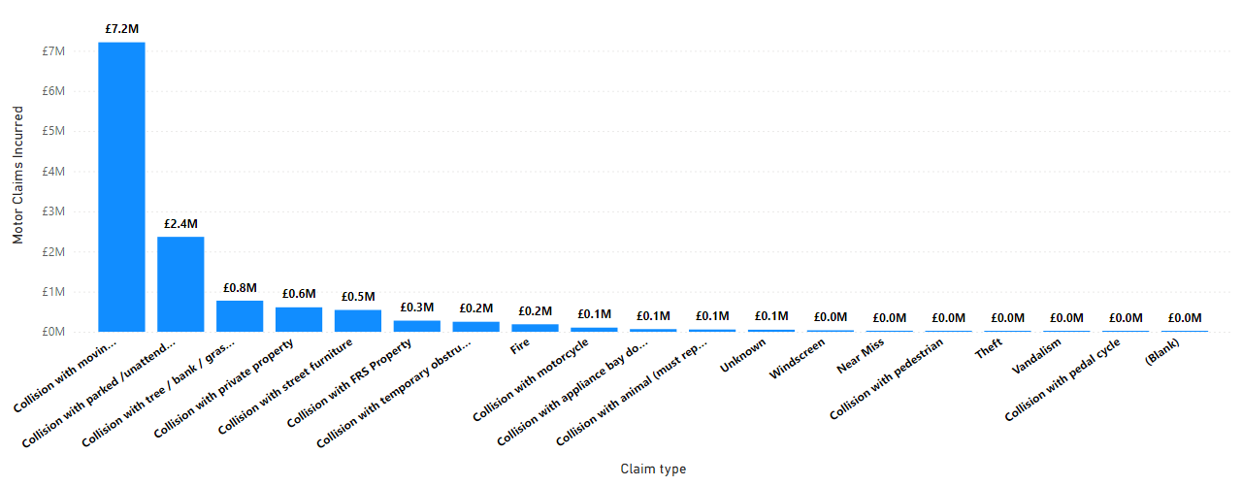
Total Cost Incurred (FRIC and Member since 2015)

Slide 13
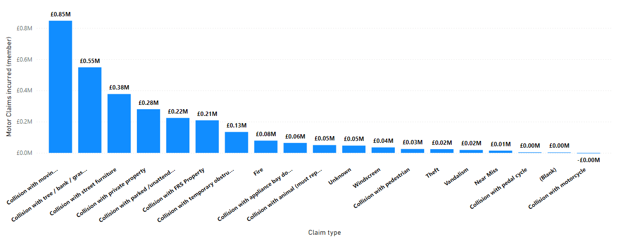
Member Incurred costs only…
Notes:
You might say that’s what we pay our contribution for but above graph shows cost to Authorities only for own damage below retention etc

Slide 14

Blues on and Blues Off
Notes:
Some insight with regards to Blues on and Off……

Slide 15
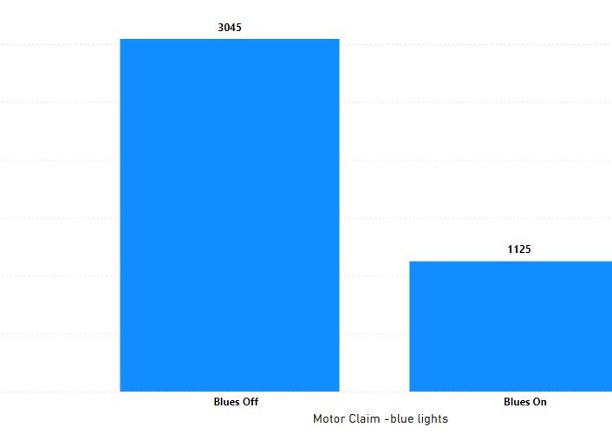
Blues On and Off Motor Claims Count
3045
1125
Notes:
On average 3 X more likely to have an accident with Blues Off…..Why and what can be done ?

Slide 16
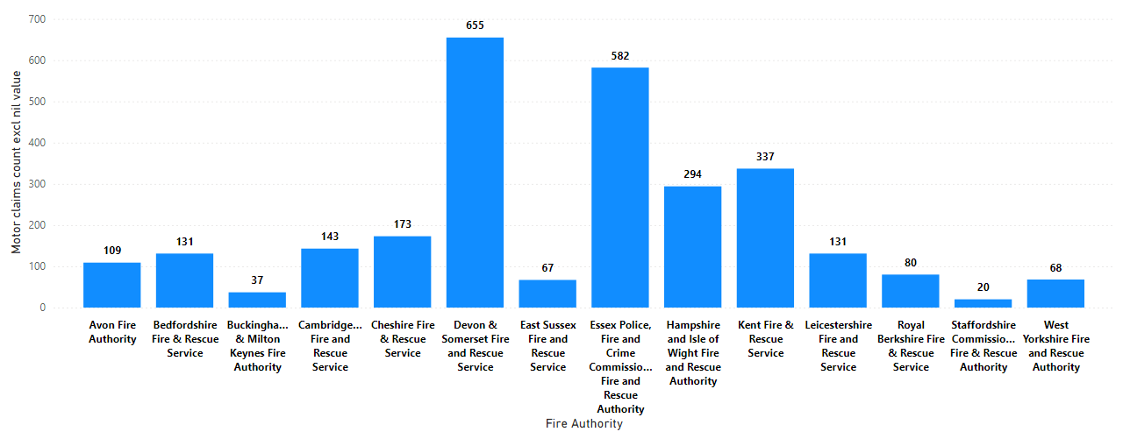
Motor Claims Count excl Nil value – Blues Off

Slide 17
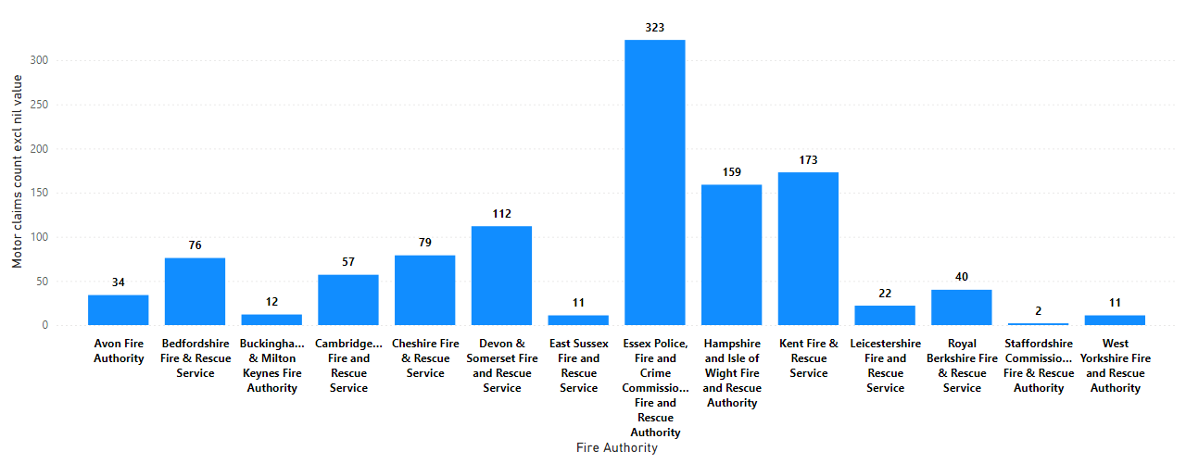
Motor Claims Count excl Nil value – Blues On

Slide 18
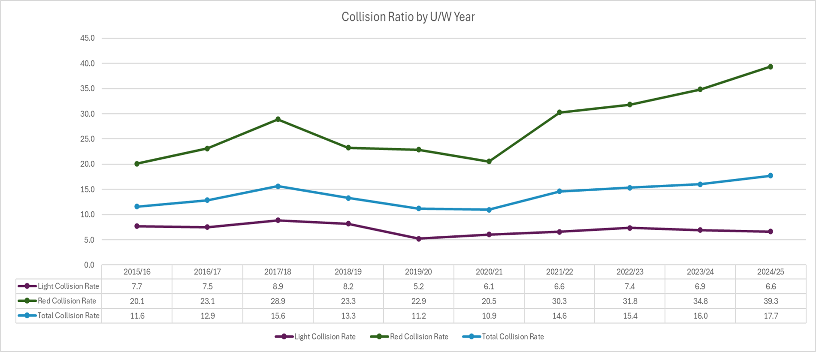
Claims Frequency Ratio – excludes Nil
Notes:
Red fleet increase since 2019/20 – no major issues with Light fleet What is causing the red fleet increase ?

Slide 19
My Question to you is why?
Collision ratio creeping up?
Notes:
Why do we think that the red fleet collision ratio is increasing ?

Slide 20
How can we reduce collision with Parked and Unattended Vehicles?
Over to you…………..
Notes:
But more importantly ….No one has an accident on purpose so how we can look to reduce these type of claims and also save money all round

Slide 21
Possible Causes ?
Seasonal Geographical and modern housing development Driver training and less experienced drivers –experienced drivers left during Covid? Pressure on getting to an incident quickly – drive to arrive? Illegal parking being ignored by Police and lack of common sense by people
More focus and concentration when going to an emergency call out
Tiredness post call out event and ‘coming down’ from adrenalin? More call outs than ever before New Fire engines are badly designed –narrow at the front and wider at the back. Too much reliance on in cab cameras and not using banksman properly when reversing More cars then ever on the road Blind spots on fire engine for driver
More social media awareness campaign
Flyers to all personnel , driver raining etc highlighting costs involved?
Drivers to review CCTV with trainers
Notes:
Awareness of costs for drivers , educate communities (leaflets, Tik Tok, Insta, Facebook etc ), Fleet design considerations, analyse drivers driving

Slide 22
Liability Claims
Trends

Slide 23
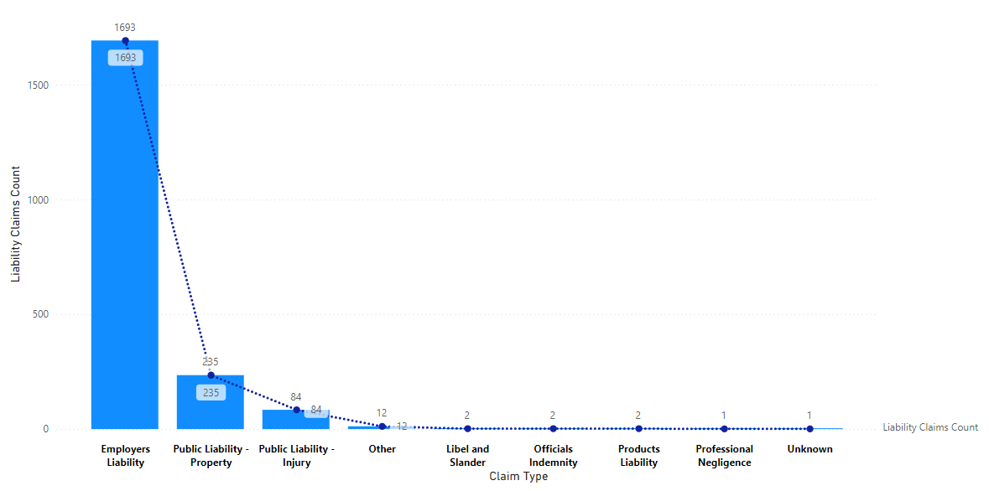
Liability Claims Count (incl Notification Only)
Notes:
EL are the majority of our liability claims notified, but 80 % are for notification only and do not result in a claim.

Slide 24
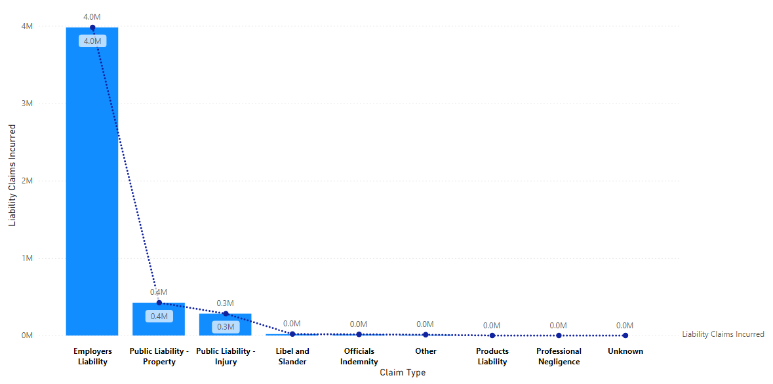
Liability Claims Incurred (FRIC and Member)
Notes:
You can see where the bulk costs it! Can not over emphasise the importance of consistent and speedy reporting so that we can carry out any investigations at an early stage rather than 3-4 months down the line when the solicitors write to us. Maybe clarify the Claims Portal?

Slide 25
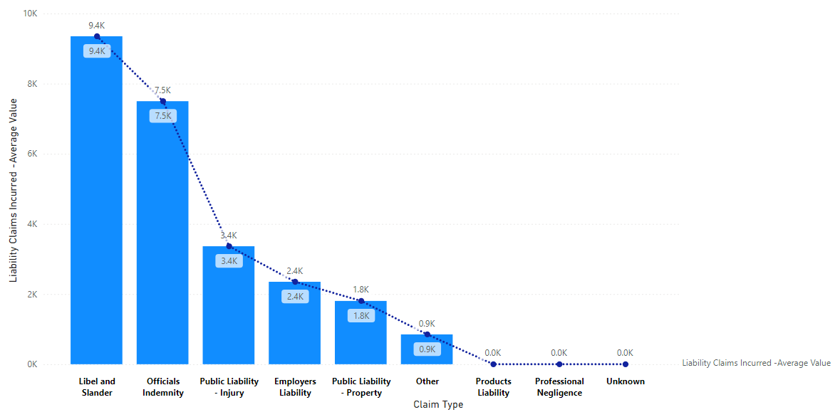
Liability Claims Incurred- average value (excl £nil)

Slide 26
How can liability claims be prevented or is it a hazard of the role of a Fire Fighter?
Some of the more unusual EL claim notifications we have seen:
Whilst shutting a brigade van door, X shut his finger in the door
Whilst clearing out the kitchen sink in preparation to drain oil/fat from the roast dinner, pouring commenced whilst a hand was still in the vicinity of sink.
Whilst exercising in gym - using dumb bells (10kg) x felt a pop in his right elbow.
Banged her shin while stepping into the mini bus.
Whilst trying to fit a window lock to the window of the property, a first floor child's bedroom, a screw came into contact with the window and cracked the glass.
Walking up grass embankment and felt right calf muscle pop
Course candidate was pulling on fire boots and pulled hamstring right leg.
Whilst removing leggings felt pain to middle finger of right hand. observed tip of finger was at 90 degrees to the rest of the finger.
Climbing through window without tunic on.
During RTC training, role as casualty and drivers curtain air bag deployed and hit head and neck, full PPE was worn
Tweaked / pulled lower back picking up E-draulic cutters off the ground
Pulled muscles in chest through exertion during annual fitness assessment - Bleep Test
The IP was cutting a cable tie when the knife he was using slipped causing the blade of the knife to penetrate his thigh
Fallen off push bike whilst responding to an incident. Slipped on the ice.
op and bottom of lip split and tooth broken whilst running out delivery hose, struck by coupling.
Lifting bariatric patient on mibs stretcher
Burn to finger and thumb from hot mug after mug reheated in microwave.
Running on treadmill suddenly stopped
Attempting to kick down door when attending persons reported fire suffered minor injury to right ankle.
Whilst rescuing a cat stuck between the glass panel of an external balcony and the brick wall on the first floor of a building, the cat proceeded to bite my index finger on my right hand. I was wearing my technical rescue gloves at the time.
Hose put down wrong chimney causing water and soot damage to carpets, furniture and upholstery.
Notes:
I don’t want to make light of any EL claims as FF can get seriously injured in the course of their duties, but these are some of the more unusual circumstances we have seen…..and some of them conjure up some very visual pictures in my mind!
In the end many of the examples never led to a claim [ was the Member negligent?

Slide 27
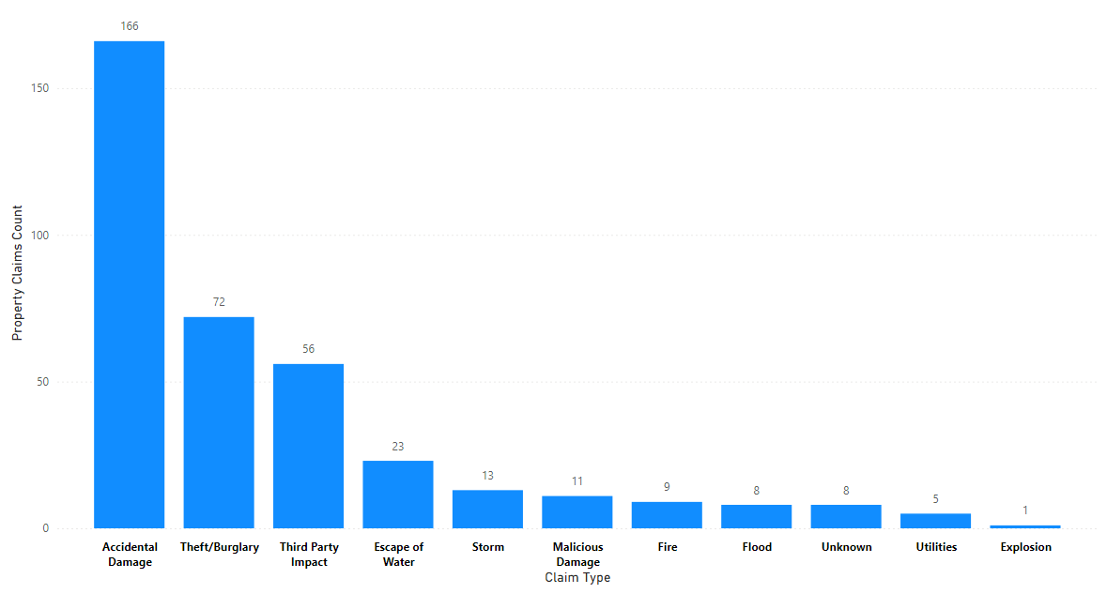
Property Claim Volumes by Type

Slide 28
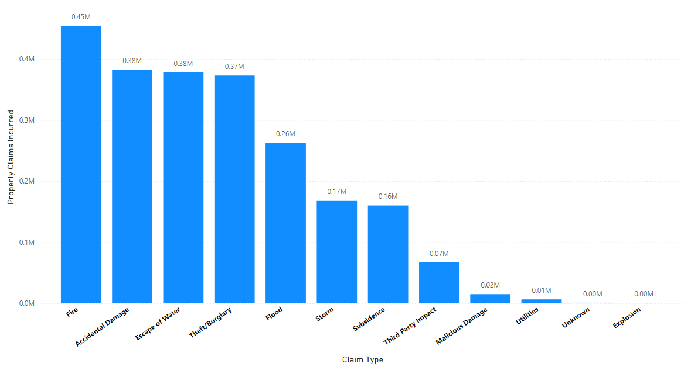
Property Claims Incurred

Slide 29
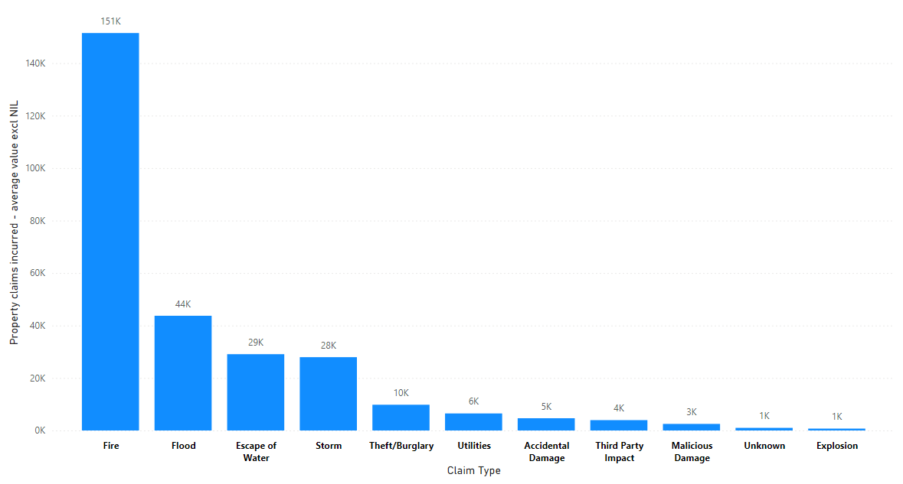
Property Claims –average value excl £nil
Notes:
And finally ….

Slide 30


Notes:
Just a reminder that all the MI came from Power BI and once you find your way around , it isn’t that difficult – happy to show individuals more

Slide 31

Questions?

