Slide 1

Power BI introduction
21 May 2025

Slide 2
Introduction to Power BI
Navigation: Understanding how to navigate through the Power BI interface to access various features and functionalities.
Exporting Data: how to export data from Power BI to other formats for further analysis or sharing.
Filters: Using filters to refine and focus on specific data within your reports.
Bookmarks: Creating and using bookmarks to save specific views of your reports for easy access and presentation.
Explore: Exploring data in-depth to uncover insights and trends.
Notes:
Pages:

Slide 3
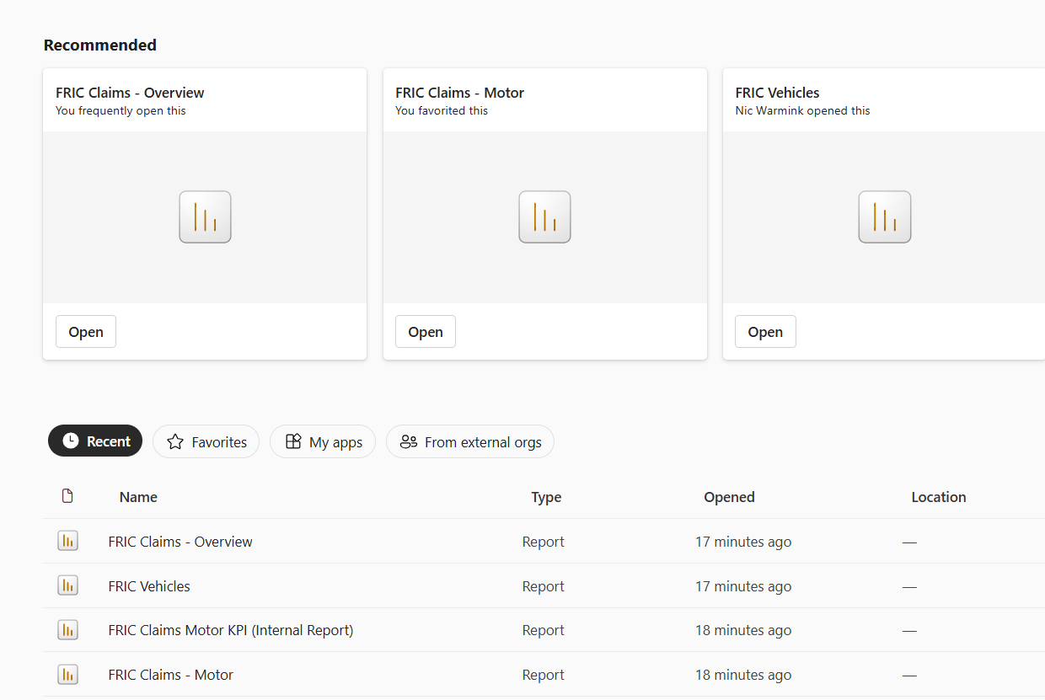
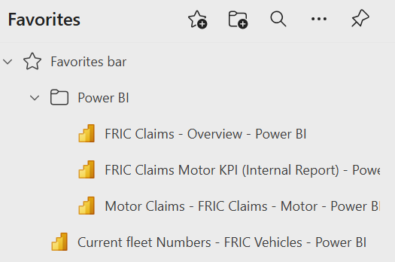
Access

Slide 4
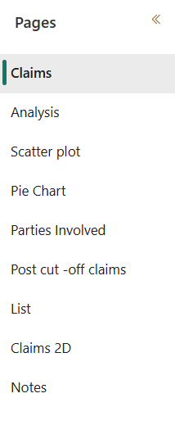
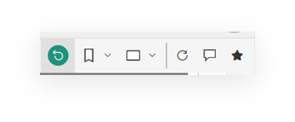

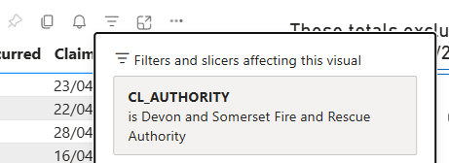

Navigation
Notes:
Pages:
Located on vertical left hand pane
Horizontal, located at the top of screen:
file, export, share, explore, subscribe, ellipsis
Left hand side
Reset all, bookmark, change screen view, refresh visuals, comment, add as favourite
Hover over right hand side of any table
Pin, copy as image with caption, set alert, filters, focus mode (expands screen by closing side bars, ellipsis opens up export options

Slide 5
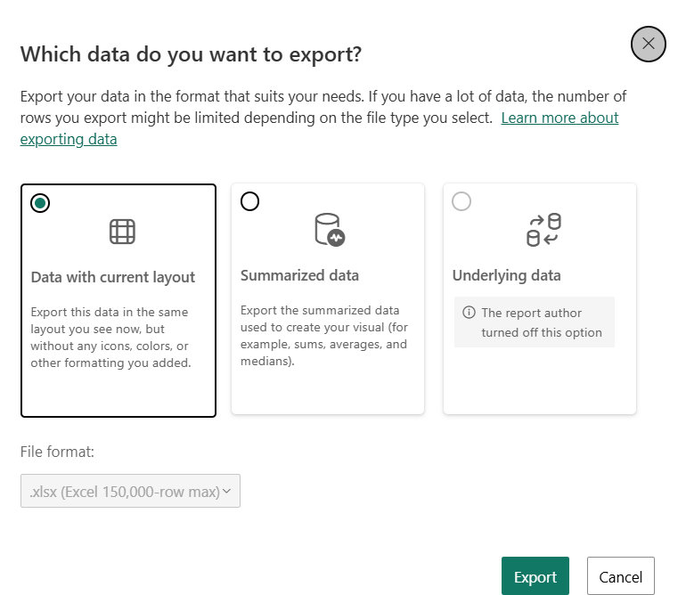
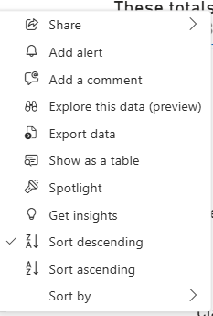
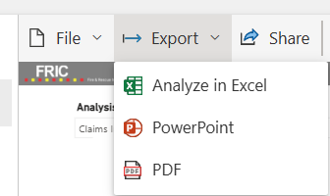
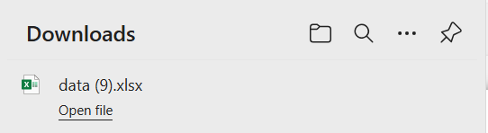
Exporting Data
Notes:
Two options:
Hover menu, ellipsis, menu select export, 3 options, downloads to excel.
Or
Top menu, export to analyse in excel, PowerPoint or PDF

Slide 6
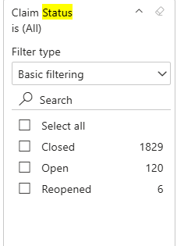
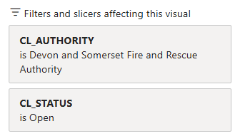
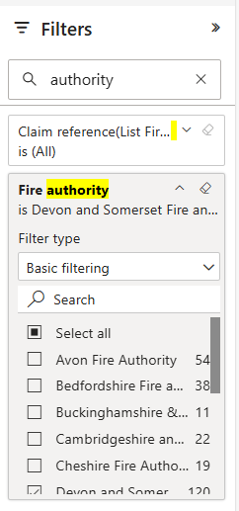
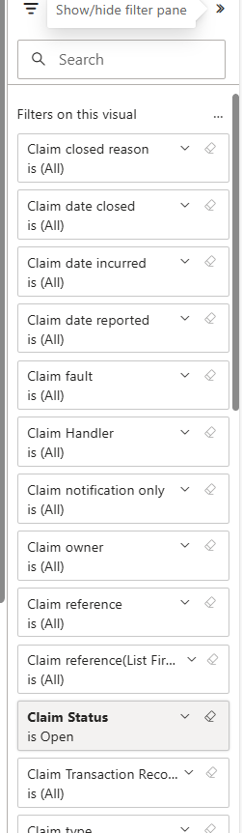
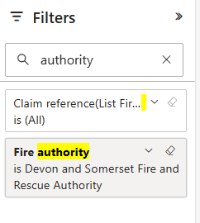
Filters
Notes:
Hover menu, 3 lines
Displays filters applied and opens up right hand filter side bar

Slide 7

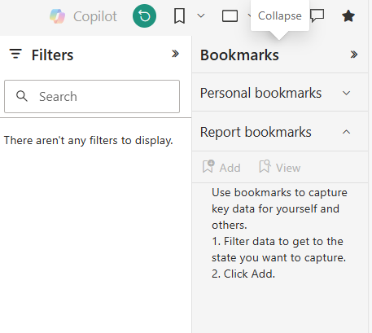
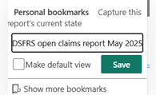
Bookmarks
Notes:
Right hand side top menu, set bookmarks for frequently used reports. When bookmark applied shows orange.

Slide 8
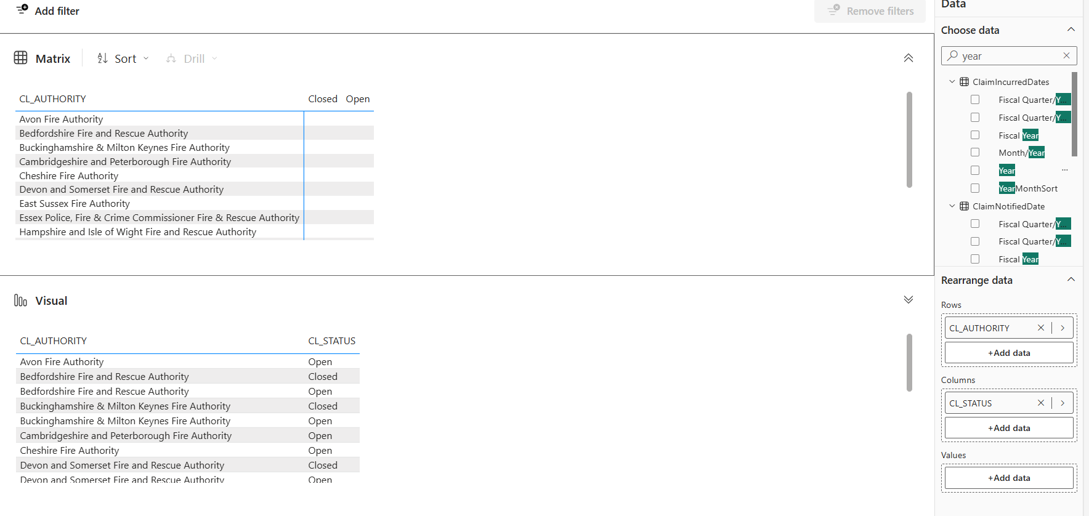
Explore
Notes:
Top menu, explore option, can switch view between vertical and horizontal.

Slide 9
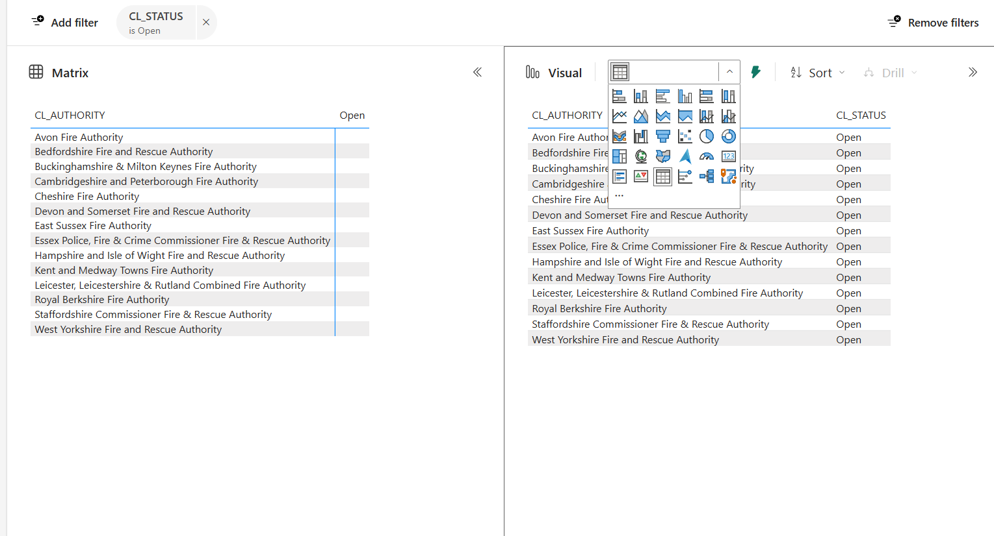
Explore

Slide 10
Power BI learning points:
Navigation: Understanding how to navigate through the Power BI interface to access various features and functionalities.
Exporting Data: how to export data from Power BI to other formats for further analysis or sharing.
Filters: Using filters to refine and focus on specific data within your reports.
Bookmarks: Creating and using bookmarks to save specific views of your reports for easy access and presentation.
Explore: Exploring data in-depth to uncover insights and trends.
Notes:
Pages:

