Slide 1
Member Interest Group
Advancing the risk management, business continuity and fraud prevention agenda
April 2025
Notes:
HM government – The Orange Book: Principle A –risk management shall be an essential part of governance and leadership and fundamental to how the organisation is directed, managed and controlled at all levels.

Slide 2
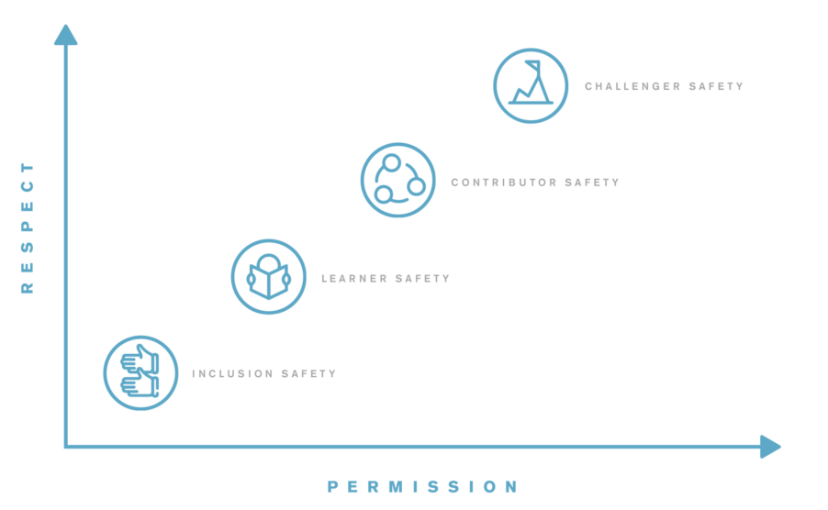
Safe space
Notes:
What is psychological safety and why is it the key to great teamwork? | Impraise
https://youtu.be/LhoLuui9gX8

Slide 3
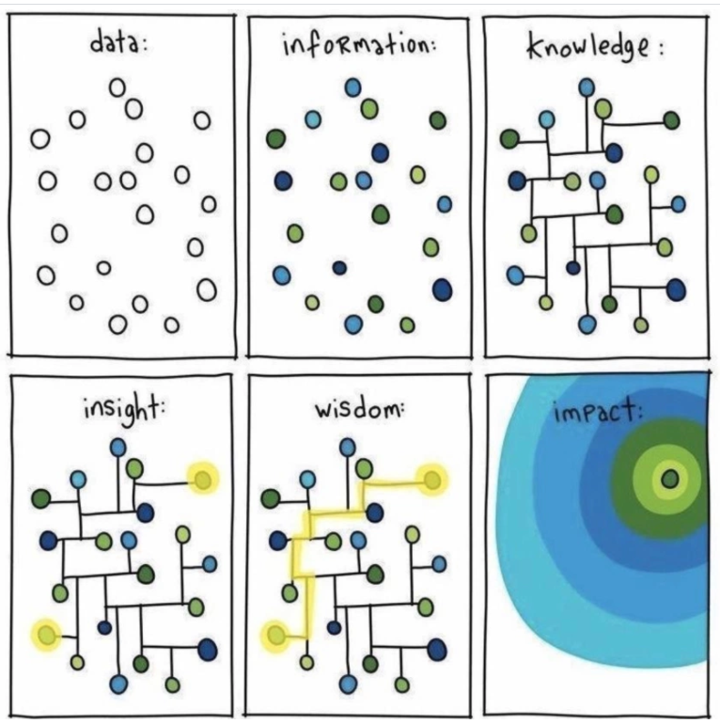
Connecting the Dots
Managing risk is about keeping an eye on the horizon for matters that may affect a process, plan, project or activity and taking corrective action to mitigate appropriately.
Notes:
Connecting the dots, data silo’ d moving towards knowledge to inform decision making
Helps FRS achieve stated objectives and better deliver on intended outcomes.
Helps managers to demonstrate good governance, better understand their risk profile and better mitigate risks (particularly uninsurable risks).
Enhances political and community support and satisfy stakeholders expectations on internal controls.
Through the identification of risks to these activities that may need a Service decision to resolve.
Better mitigation of key risks.
Protection of assets.

Slide 4
ABC of Risk Culture
Notes:
HM government – The Orange Book: Principle A –risk management shall be an essential part of governance and leadership and fundamental to how the organisation is directed, managed and controlled at all levels.
FIRST PRINCIPLES –A B C Model
•(Risk) attitude -position of individual or group towards risk –influenced by risk perception
•(Risk) behaviour–actions decisions-making, processes communications relating to risk
•(Risk) culture -values, beliefs, knowledge and understanding shared by a group with a common purpose.

Slide 5
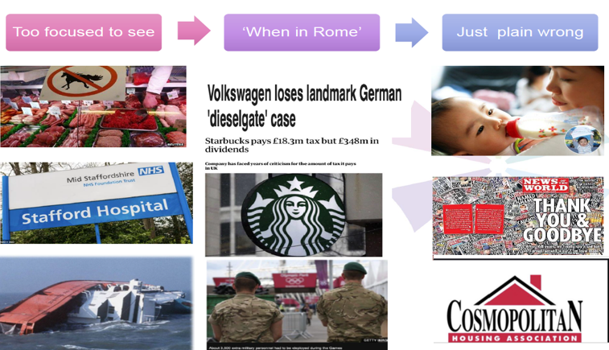
Risky behaviour
Notes:
Select either slide 4 or 5 dependant on audience.
Ethics and risk: spectrum of bad risk behaviour.
Refer to Stafford Hospital case study & risk culture diagnostic.
Horse meat scandal: The Food Safety Authority of Ireland tested a range of cheap frozen beefburgers and ready meals from supermarkets last November for the presence of DNA from other species which were undeclared. It found horse DNA in over one-third of the beefburger samples, and pig in 85% of them.
Stafford Hospital case study: get in touch to work through organisational failures and impact on patients.
Herald of free enterprise ferry, Zeebrugge: As the Captain of the ship couldn’t see the bow doors from the bridge and there was no other way to substantiate if the doors were open or not, besides a visual check of the doors themselves, he relied solely upon the Chief Officer’s report that all was well. To add to the dilemma, design incompatibility of the ferry and the link-span mechanisms at Zeebrugge meant the ferry’s vehicle loading decks could not be loaded properly. The loading ramp at Zeebrugge couldn’t be raised high enough, so to compensate, the Herald of Free Enterprise was lowered in the water by 3 feet by filling its ballast tanks with water. A recipe for disaster.
Volkswagen: set objectives in respond to the Clear Air Act, the subsequent emissions scandal, also known as Dieselgate or Emissionsgate began in September 2015, when the United States Environmental Protection Agency (EPA) issued a notice of violation of the Clean Air Act to German automaker Volkswagen, millions paid in compensation
Starbucks tax avoidance: Starbucks managed to avoid making any profit in the UK, apparently, by: ... Funding the whole UK operation on debt to other Starbucks subsidiaries, paying interest (which is tax deductible in the UK) at high or inflated rates.
Olympic games G4S failures: provided less than 6,000 of the 10,000 security guards required, military deployed to largest ever peacetime event.
Baby milk formula: The scandal involved milk and infant formula along with other food materials and components being adulterated with melamine. ... Of an estimated 300,000 victims, 6 babies died from kidney stones and other kidney damage and an estimated 54,000 babies were hospitalized
News of the World: organisation collapsed due to phone hacking scandal, Milly Dowler. The News International phone-hacking scandal was a controversy involving the now-defunct News of the World and other British newspapers owned by Rupert Murdoch. ... Advertiser boycotts led to the closure of the News of the World on 10 July 2011, after 168 years of publication.
Cosmopolitan Housing Association: Had routine regulation in the early 2000s been more effective, the crisis may have been prevented. The lessons learned for the sector and regulator focus on five themes: skills and resources, information requirements, risk management, mergers, and how housing providers and the regulator should act in a crisis. The report also suggests that the government reviews the relevant legislation to ensure that the regulator is not hampered if this situation were to unfold in the future.
Covid 19!

Slide 6
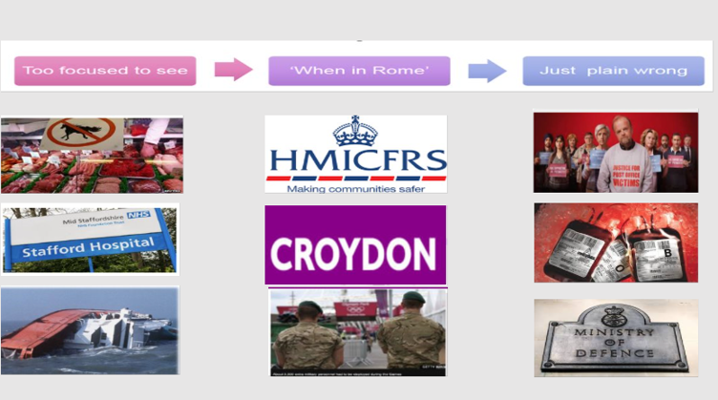
Risky behaviour
Notes:
Ethics and risk: spectrum of bad risk behaviour.
Refer to Stafford Hospital case study & risk culture diagnostic.
Between 1970 and the early 1990s, more than 30,000 NHS patients were given blood transfusions, or treatments which used blood products, contaminated with hepatitis C or HIV. Over 3,000 people have died as a result, and thousands live with ongoing health conditions.
Horse meat scandal: The Food Safety Authority of Ireland tested a range of cheap frozen beefburgers and ready meals from supermarkets last November for the presence of DNA from other species which were undeclared. It found horse DNA in over one-third of the beefburger samples, and pig in 85% of them.
Stafford Hospital case study: get in touch to work through organisational failures and impact on patients.
Herald of free enterprise ferry, Zeebrugge: As the Captain of the ship couldn’t see the bow doors from the bridge and there was no other way to substantiate if the doors were open or not, besides a visual check of the doors themselves, he relied solely upon the Chief Officer’s report that all was well. To add to the dilemma, design incompatibility of the ferry and the link-span mechanisms at Zeebrugge meant the ferry’s vehicle loading decks could not be loaded properly. The loading ramp at Zeebrugge couldn’t be raised high enough, so to compensate, the Herald of Free Enterprise was lowered in the water by 3 feet by filling its ballast tanks with water. A recipe for disaster.
HMICFRS: ITV 4 documentary: FRS and Police accused of significant failures: institutionally misogynistic, racist and homophobic – MPs informed 5 March 2024
Local Authorities bankruptcy: Councils across the country find themselves in a turbulent financial position. Eight English councils have declared themselves in effect bankrupt since 2018, including four in the past 15 months, including Woking, Nottingham, Birmingham and Thurrock. Several others have planned major cuts in an explicit attempt to stave off insolvency
Olympic games G4S failures: provided less than 6,000 of the 10,000 security guards required, military deployed to largest ever peacetime event.
Post Office horizon: 1999 – 2024 Horizon was developed by the Japanese company Fujitsu, for tasks such as accounting and stocktaking. It was introduced by the Post Office in 1999. Sub-postmasters quickly complained about bugs in the system after it falsely reported shortfalls - often for many thousands of pounds - but their concerns were dismissed
NHS blood transfusion scandal Between 1970 and the early 1990s, more than 30,000 NHS patients were given blood transfusions, or treatments which used blood products, contaminated with hepatitis C or HIV. Over 3,000 people have died as a result, and thousands live with ongoing health conditions
MoD cyber attack and supply chain security contract: on the 6 May news broke of 270,000 service personnel working for the UK MOD had been accessed. It was part of a cyber espionage operating targeting a contractor responsible for managing the payroll system. A similar breach occurred in 2014 to US officer of personnel management and involved 22.1 million individual records. The contractor did not inform MOD of the breach which is believed to have occurred early 2014 until after they had been awarded MOD IT security contract.
A few more examples
Volkswagen: set objectives in respond to the Clear Air Act, the subsequent emissions scandal, also known as Dieselgate or Emissionsgate began in September 2015, when the United States Environmental Protection Agency (EPA) issued a notice of violation of the Clean Air Act to German automaker Volkswagen, millions paid in compensation.
Starbucks tax avoidance: Starbucks managed to avoid making any profit in the UK, apparently, by: ... Funding the whole UK operation on debt to other Starbucks subsidiaries, paying interest (which is tax deductible in the UK) at high or inflated rates.
Cosmopolitan Housing Association: Had routine regulation in the early 2000s been more effective, the crisis may have been prevented. The lessons learned for the sector and regulator focus on five themes: skills and resources, information requirements, risk management, mergers, and how housing providers and the regulator should act in a crisis. The report also suggests that the government reviews the relevant legislation to ensure that the regulator is not hampered if this situation were to unfold in the future.
Covid 19!
Baby milk formula: The scandal involved milk and infant formula along with other food materials and components being adulterated with melamine. ... Of an estimated 300,000 victims, 6 babies died from kidney stones and other kidney damage and an estimated 54,000 babies were hospitalized
News of the World: organisation collapsed due to phone hacking scandal, Milly Dowler. The News International phone-hacking scandal was a controversy involving the now-defunct News of the World and other British newspapers owned by Rupert Murdoch. ... Advertiser boycotts led to the closure of the News of the World on 10 July 2011, after 168 years of publication.

Slide 7
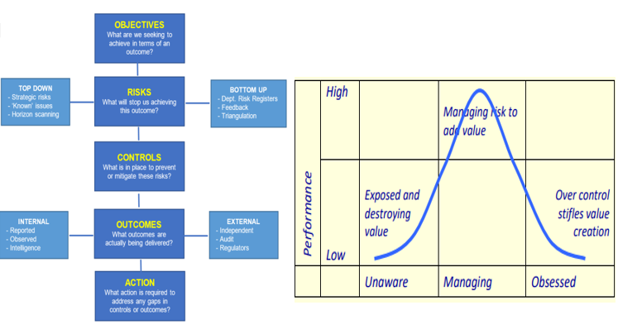
Risk management framework
Notes:
Risk management framework
Risk management is the process by which risks are identified, assessed, recorded, mitigated and reviewed. A risk is the threat that an event or action will adversely affect the ability to achieve our objectives. This Risk Management Framework sets out responsibilities for the management of risk and seeks to ensure that key risks to the achievement of FRS objectives are understood, reported and appropriately mitigated.
It is important to recognise that an effective risk management framework is as much a way of thinking as it is a process or system as illustrated in the following diagram.
Optimising Risk Management Value
Control failure examples:
Two councils pay £3m to child abuse victims
Barnet Council chief steps down after mayoral election vote chaos
HMICFRS reports
Accelerate action implementation, reduce time risks on CRR
Graph illustrates the optimum position for risk management:
To the left of the graph the organisation is unaware of the risks that it faces and is consequently exposed to risks which are likely to increase costs and reflect in a low overall performance.
• To the right of the graph, risk is managed in minute detail resulting in over control which stifles innovation and once again reflects in low overall performance.
• Good risk management aims to pitch at the centre of the graph where key risks are managed in a systematic way to add value to the organisation and create high performance.

Slide 8
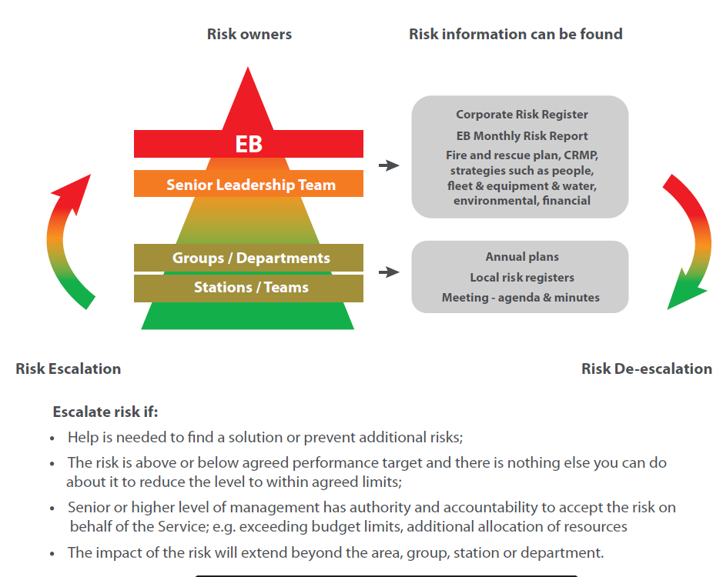
Risk escalation
Notes:
Essential feature of risk management process – how often should risks / issues be discussed & escalated / de-escalated – monitoring frequency – links back to risk management framework.
Red – monthly
Amber – quarterly
Green – annual

Slide 9
Fraud prevention and NFI
Is fraud a criminal offence?
Is there fraud legislation?
What are the most common types of fraud in public sector?
Each year how much money is lost to fraud or errors?
  £310k
  £3m
  £190 bn
Has FRS lost money to fraud or errors?
Governance
5. What are FRS responsibilities to protect and make better use of public money?
6. How many cases of fraud are reported annually?
7. What is NFI?
Notes:
National Fraud Initiative - GOV.UK a data matching exercise operated by the Public Sector Fraud Authority that helps to prevent and detect fraud.
Common types of public sector fraud
Assets: use of organisation equipment, printing, postage
Procurement: bid rigging, kick backs
Payroll: ghost employees, claiming too much money, manipulation of rules for financial and benefits gains
Expenses: submit false claims, inflate mileage – all for personal gain
Flexi time: record extra or loss of time
Fraud risks:
Financial
Reputational
Threat to life or serious injury
Criminal or civil liability issues
Ongoing service availability
Victims
ADD FRS fraud cases – statutory requirement to annually report and publish number of cases.

Slide 10
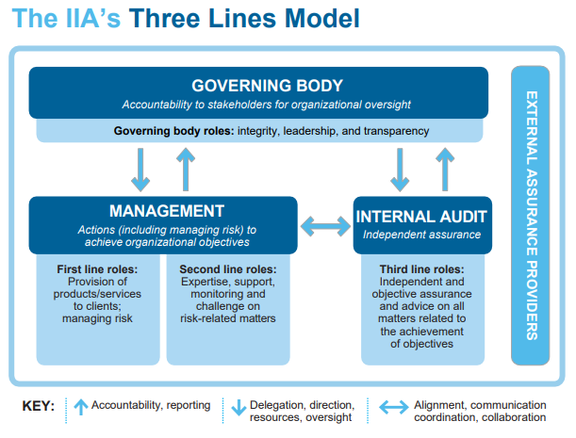
Governance, management and controls
Notes:
© Institute of Internal Audit three lines of assurance

Slide 11
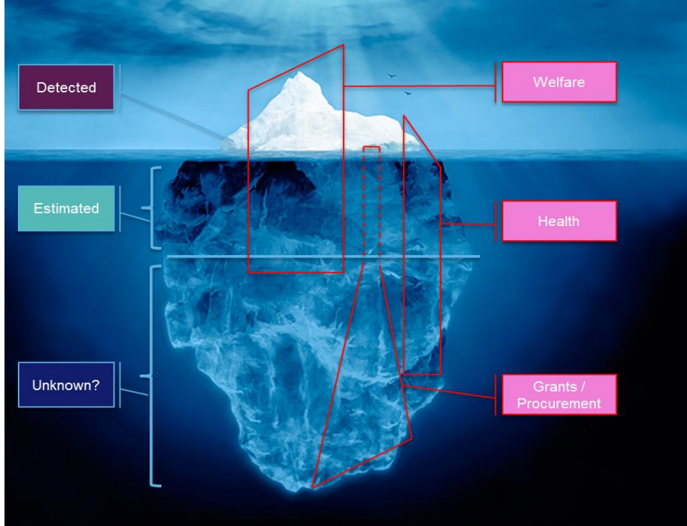
How much!!!
The annual cost of fraud in the UK is £190 billion, equal to nearly £7,200 per household.
Fraud is now the UK’s most common criminal offence.
The cost of fraud to the UK is greater than the Gross Domestic product of 148 out of 191 countries.
At £190 billion it would represent more than the UK government spends on health and defence combined, or all welfare payments excluding pensions.
Finding fraud is a good thing
There is no one solution
Fraud & corruption is ever changing
Prevention is the most effective way to mitigate fraud risks
There is always going to be fraud
Notes:
Public Sector Fraud Authority 2023/24 Delivery (HTML) - GOV.UK (www.gov.uk)
2017-09-06_Cross_Government_Fraud_Landscape_Annual_Report_final.pdf (publishing.service.gov.uk)

Slide 12
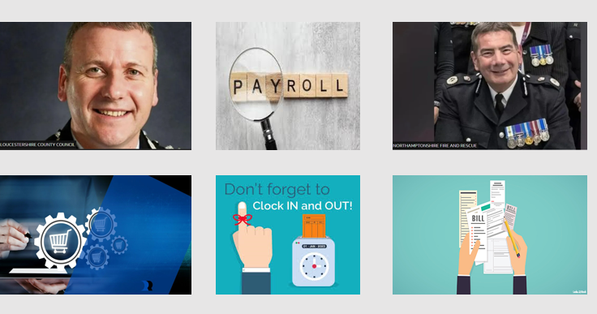
Fraud cases
Notes:
Stewart Edgar oversaw a tender process in which a Gloucestershire Fire and Rescue Service Land Rover was sold for far less than its £5,000-£8,000 value.
He then "went on to purchase the vehicle from the successful bidder", Gloucestershire County Council said.
The authority released the information saying it wanted to be "transparent".
"The internal audit investigation identified poor judgement by the chief fire officer in not recognising the significance of his interest in acquiring a vehicle he'd had oversight of the disposal process for," said council chief Pete Bungard.
The council revealed that:
A 15-year-old Land Rover Discovery was put up for disposal via a formal tender process to an approved list of companies
A bid of £500 was accepted and a second, higher bid which missed the tender deadline, was not considered
However, in another vehicle sale late bids were received and accepted
Having accepted the £500 bid, Mr Edgar went on to buy the vehicle from the successful bidder
He has offered to return the vehicle to ensure the council does not suffer a financial loss
Examples of Fraud – National Fraud Initiative (NFI) – Cabinet Office
NFI: public sector case studies and testimonials - GOV.UK (www.gov.uk)
Birmingham City Council
A Payroll report identified an employee who had joined Birmingham City Council but also held a casual role as bank staff at a local NHS Trust. The report highlighted that the salary for the casual role was higher than would be expected. Initial enquiries established that the employee was working full time for both organisations. An investigation found that both roles were being undertaken whilst working at home, allowing the fraudulent claims to be made. It also identified a period where the individual had worked for one organisation whilst claiming to be unfit for work at the other. The employee was dismissed from both roles. Recovery of the salary paid by the Council, which was in excess of £16,500, is being pursued.
Anonymous
A County Council is in the process of recovering a £30,000 overpayment of salary after the NFI identified an individual who appeared to be employed by two different local authorities, both on a full-time basis. The investigation established that the individual had applied and been offered a job at one authority, however they did not accept or start employment. Despite this, they were set up on the payroll and monthly payments were made. The individual did not query the payments. This was not picked up by internal controls due in part to the fact that the role was in a team managed by the NHS but funded by the council.
Nick Adderley facing second criminal inquiry - BBC News
Northamptonshire's suspended chief constable is facing a second criminal inquiry, it has emerged.
Nick Adderley is under investigation at his former force, Staffordshire Police, over allegations of fraud in relation to the maintenance of police vehicles.
Northamptonshire Police will work hard to rebuild public trust and confidence after the dismissal of Chief Constable Nick Adderley, who has been found to have committed gross misconduct.
This morning (Friday 21 June), an independent panel decided that Chief Constable Nick Adderley had breached the standards of honesty and integrity and should be dismissed without notice and placed on the policing barred list.
Banking fake applications and pension claims £178k
Stealing train tracks
Wills beneficiary £634k (money intended for cancer charities)
Money laundering (cash couriers) £104m
Universal credit benefit fraud gang £53m
Houseboat fraudulent sales £3.5m
Roofing work false claims £88k
Life savings £12m
False injury claims
Fraud and economic crime | The Crown Prosecution Service (cps.gov.uk)
Banking fraudster sentenced
A banking fraudster has been sentenced for making fake applications to banks and a pension company to obtain loans, banking, and pension facilities, totalling around £178,000 in potential losses.
Michael Cross, 38, has today been sentenced to three years imprisonment at Inner Crown Court London.
Continue reading Banking fraudster sentenced
A gang of conspirators have been sentenced for stealing train track rails
A gang of seven men have been sentenced at Sheffield Crown Court for stealing train track rails.
Jaspreet Oberoi, 40, Lee Clark, 48, Dean Tonks, 38, Ricky Collins, 40, Daniel Hemmings, 77, David Aignotti, 58 and Shaun Webber, 41, were sentenced to 30 months imprisonment, 27 months imprisonment suspended for two years, 15 months imprisonment, 12 months imprisonment suspended for two years, 42 weeks imprisonment suspended for two years, 49 weeks imprisonment suspended for two years respectively for conspiracy to steal offences.
Continue reading A gang of conspirators have been sentenced for stealing train track rails
Tamworth women jailed after defrauding £634,000 from the beneficiaries of wills
Two women from Tamworth have today been jailed for defrauding and laundering more than £634,000 from estates of the deceased, including money intended for life-saving charities such as Cancer Research and Great Ormond Street Hospital.
Continue reading Tamworth women jailed after defrauding £634,000 from the beneficiaries of wills
Two money laundering cash couriers sentenced for part in transporting £104m in criminal cash out of the UK
Two money laundering cash couriers were imprisoned today (26 April 2024), for their role in transporting illegally obtained money out of the United Kingdom.
Mehdi Amrollahibyouki, 41, and Ali Al Nawab, 44, were sentenced to four years imprisonment and two years imprisonment suspended for two years respectively for money-laundering related offences at Isleworth Crown Court.
Continue reading Two money laundering cash couriers sentenced for part in transporting £104m in criminal cash out of the UK
Members of Britain’s biggest benefit fraud gang jailed for a combined total of more than 25 years
Five members of an organised criminal gang, which falsely claimed more than £53 million in Universal Credit in the largest benefit fraud in England and Wales, have been jailed.
Continue reading Members of Britain’s biggest benefit fraud gang jailed for a combined total of more than 25 years
UPDATED WITH SENTENCE: Houseboat tycoon convicted for multi-million-pound fraudulent sales
A property tycoon has been given a sentence of 12 years' imprisonment after having been found guilty of a £3.5 million fraud over claims he sold houseboats on a stretch of the river Thames that could not be lived in.
Myck Djurberg (64) was convicted at Kingston Crown Court for fraudulently selling houseboats without appropriate planning permission on 19 March 2024 and was sentenced on 27 March 2024 to 12 years' imprisonment at the same court.
Continue reading UPDATED WITH SENTENCE: Houseboat tycoon convicted for multi-million-pound fraudulent sales
Specialist CPS team involved in UK’s largest Bitcoin seizure
An ex-takeaway worker has been convicted (Wednesday 20 March 2024) of laundering the proceeds which saw her rise from living above a Chinese restaurant to residing in a multi-million pound house in an affluent part of North London.
Jian Wen, 42, was found guilty at Southwark Crown Court of an offence relating to money laundering.
Continue reading Specialist CPS team involved in UK’s largest Bitcoin seizure
Former council employee jailed after roofing work fraud
A ex-council worker and a roofing firm worker have been jailed for fraud and bribery after they conspired to defraud New Forest District Council.
Former council maintenance operative Richard Cullen, aged 55 from Luton, received bribes from 34-year-old Mark Diaper, who worked at a roofing company in Southampton which is now no longer trading. The bribes were paid to secure work for which inflated invoices were submitted. The amount overcharged was more than £88,000 but the jobs referred to the company were worth much more.
Continue reading Former council employee jailed after roofing work fraud
Criminals who laundered fraudulently-obtained life savings in £12 million shares scam sentenced
Three men who laundered funds fraudulently obtained from 350 people tricked into investing more than £12 million in non-existent or worthless shares have been sentenced today.
Continue reading Criminals who laundered fraudulently-obtained life savings in £12 million shares scam sentenced
Three men convicted for offences of fraud and acquiring criminal property
Three men convicted of fraud and acquiring criminal property relating to poultry, amounting to a loss of £318,347, have today been sentenced to terms of imprisonment.

Slide 13
Legislation
Fraud Act 2006 (legislation.gov.uk)
Section 2 False statement
Section 3 Failing to disclose
Section 4 Abuse of Position
All require dishonesty, gain and or loss
New offence – failure to prevent fraud Economic Crime and Corporate Transparency Act 2023: Factsheets - GOV.UK (www.gov.uk)
Notes:
Fraud losses to high, intend to stop large scale frauds
Organisations must have adequate procedures in place, raise awareness with staff
Failure to Prevent Fraud Offence: The Government has created a new failure to prevent fraud offence to hold organisations to account if they profit from fraud committed by their employees. This will improve fraud prevention and protect victims. Under the new offence, an organisation will be liable where a specified fraud offence is committed by an employee or agent, for the organisation’s benefit, and the organisation did not have reasonable fraud prevention procedures in place.
1.Fraud
2.Fraud by false representation
3.Fraud by failing to disclose information
4.Fraud by abuse of position
5.“Gain” and “loss”
6.Possession etc. of articles for use in frauds
7.Making or supplying articles for use in frauds
8.“Article”
9.Participating in fraudulent business carried on by sole trader etc.
10.Participating in fraudulent business carried on by company etc.: penalty
Obtaining services dishonestly
11.Obtaining services dishonestly

Slide 14
FRS process
ADD LINK TO FRS PREVENITON AND DETECTION OF FRAUD & CORRUPTION
ADD LINK TO Whistleblowing Code
ADD LINK TO Register of Interests & Gifts and hospitality
ADD LINK TO ANNUAL FRAUD REPORTS – FRS WEBSITE
National Fraud Initiative - GOV.UK (www.gov.uk) We participate in the National Fraud Initiative (NFI) exercise that matches electronic data within and between public and private sector bodies to prevent and detect fraud. This exercise takes place every 2 years.
National Fraud Initiative case studies - GOV.UK (www.gov.uk

Slide 15
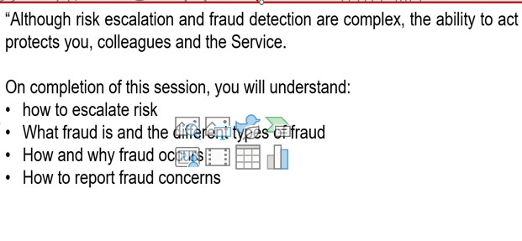
Checklist

Slide 16
What is business continuity and why is it important?

Slide 17
What is Business Continuity?
Capability of the organisation to continue delivery of products or services at acceptable predefined levels following disruptive incident (ISO 22301)
Notes:
Management process that puts FRS in a position where it can continue to deliver our critical Services in a disruptive event.

Slide 18
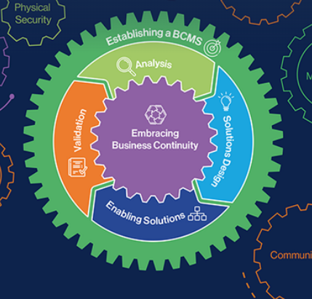
What is Business Continuity?
BCI Good Practice Guidance Edition 7
Notes:
As well as ISO22301 the BCI GPG is a framework in which we align to.
Split into 6 professional practices.
Outside – governance, policy, framework and strategy. These documents set the standards, the why and how for carrying out BC in the Service. These are reviewed when needed but at least annually.
The process looks at risks to our critical activities, how we can mitigate those risks and BC plans are the guidance for what needs to happen if an event occurs.
Plans are not considered to be effective unless they have been exercised. A debrief is carried out after each exercise or activation which then improves our resilience. Finally embracing BC sits in the heart of the system. Having staff aware of BC and prepared will enable a quicker recovery from an event.
Business Continuity policy and framework are available on the collaboration portal. Included in the policy are roles and responsibilities. Your role in relation to BC - Provide expertise, understand their role, what works, what would work, what might work, Support with plans and your stations in exercising.

Slide 19
Why?
Civil Contingencies Act 2004
Assess Risks;
Write plans;
Business Continuity;
Provide advice & assistance to businesses & voluntary organisations re Business Continuity;
Share Information;
Co-operate with other responders;
Warn, inform & Advise the public;
Notes:
FRS has a statutory duty to “maintain BC arrangements and recovery plans” in accordance with The Civil Contingencies Act 2004 and the Fire & Rescue Service Act 2004

Slide 20
Why?
Civil Contingencies Act 2004
Plans to maintained to ensure that we can continue to perform our functions at pre-determined levels.
Procedure for invoking plans
Plans should be exercised to check plans work
Key staff must be trained
Plans should be reviewed
Plans should be published
Notes:
Statutory duty under the CCA 2004.
Plans to maintained to ensure that we can continue to perform our functions at pre-determined levels. This doesn’t mean every activity needs to continue but those that directly contribute to us providing a Service do. COVID
Procedure for invoking plans – internally plan owners can activate their own plans with EB lead approval, Service wide plans a DPO
Plans should be exercised to check plans work, rehearsing plans makes them familiar with key staff so when an event happens staff know exactly what to do. Plans not considered reliable until exercised.
Key staff must be trained. Training is being carried out including today,
Plans should be reviewed at least annually but also
personnel - staff turnover means that contact details will need constant updating; o
the responsibilities of the Category 1 responder - where a Category 1 responder takes on new functions or delivers new services, this should be reflected;
organisational structures - where responders have experienced restructuring this may need to be reflected in plans;
suppliers or contractors - ensuring that the details of suppliers and contractors are kept up to date;
risk assessments - the Act requires Category 1 responders to review plans in the light of changes to risk assessments; and
business objectives/processes
Does everyone know where you BCP is? Link on last slide

Slide 21
Where to find Plans
Add link / image to BC plans

Slide 22



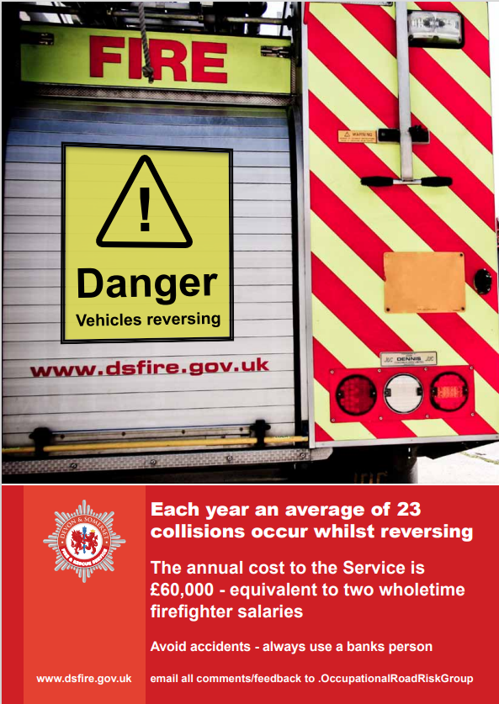
Current risks
Notes:
ICT building resilience against cyber attacks. Phishing simulations are being carried out, Training and general awareness.. A FRS suffered a cyber attack a few years ago when they lost everything. How would you continue to do your role if you lost ICT? It took years to recover.
Preparing to stand up the response team for any potential Industrial Action if a pay award can’t be agreed upon. When event will impact the whole Service or our ability to carry out our critical activities.
Power outages, and particularly NPO. Even low probability the impacts are going to be huge and government directive to make sure we are prepared. Run desktop exercise to help inform plan. NPO will be a complete loss of electricity. What have you used electricity for today? None of it would be available. BC Plan printed? Now think how that is going to impact us a Service. (no generation, fuel tanks rely on a card to dispense, no communications, toilets ) What mitigations and contingencies can we put in place??
Loss of vehicles, property and equipment, what reserves are available and supply chain timelines.

Slide 23
Benefits of Business Continuity
Builds confidence within our organisation
Minimises the effect of a disruption
Enables service delivery to continue
Retain reputation
Reduce the risk of financial loss
Overall business continuity improves our Resilience and our Capabilities

